Slide 1

Multi-level Inheritance

Slide 2
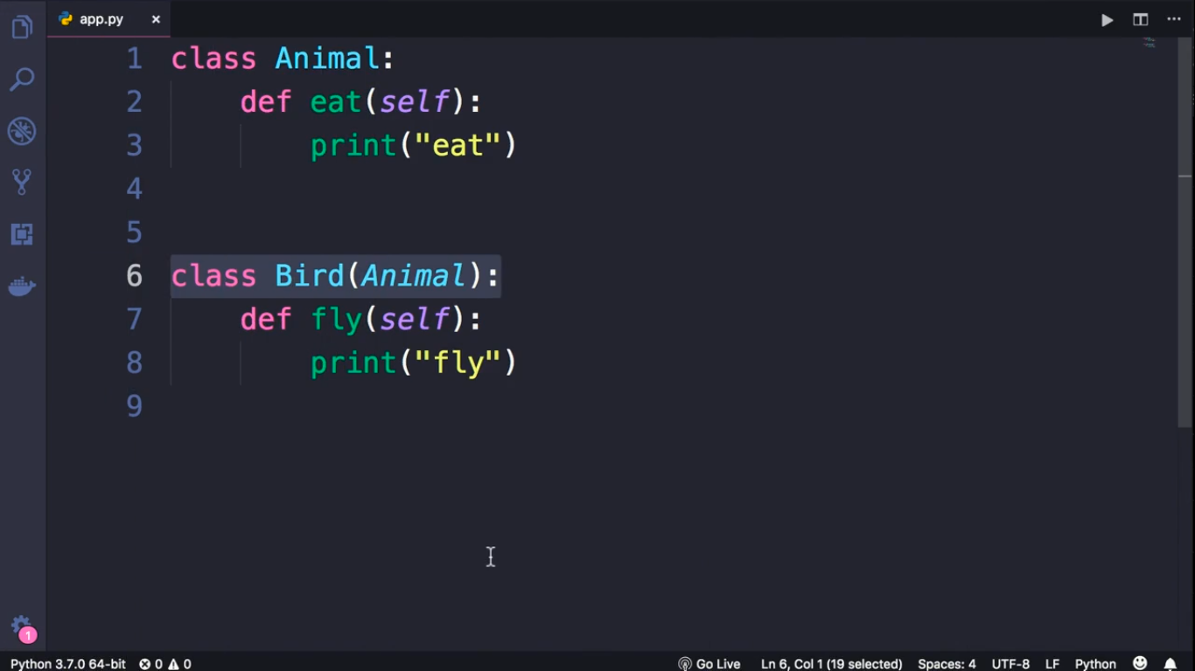

Slide 3
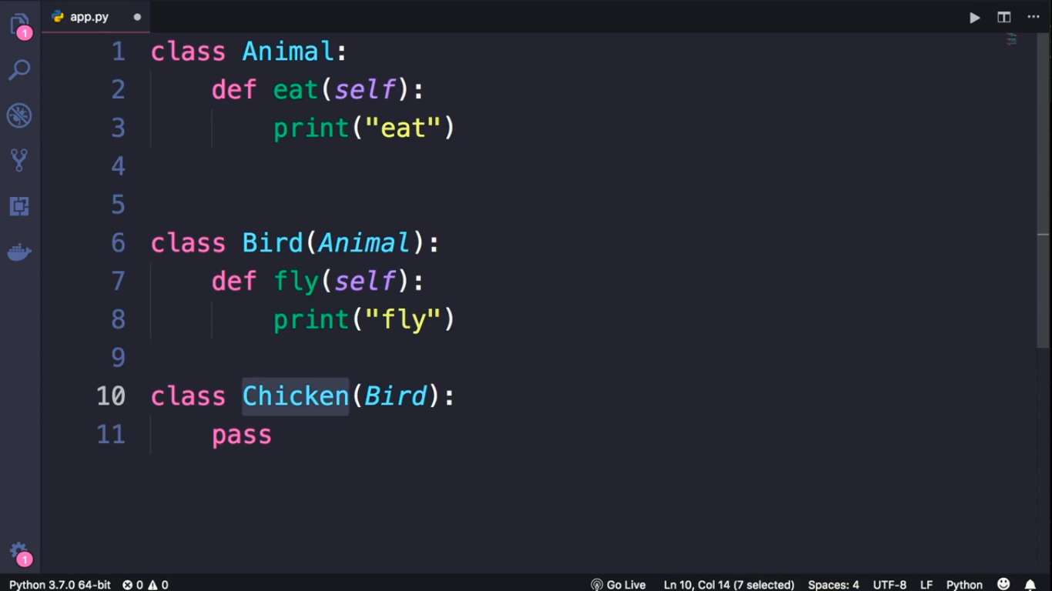

Slide 4
